Slide 1
Online Procurement Project Tracking and Monitoring System for BU Procurement Office
CA: MAAM LEA AUSTERO
PA: SIR CHRISTIAN SY

Slide 2
Overview and Background
The PrMO is one of the newest office in Bicol University as of now and the documents they are handling is a lot for they manage procurement activities of the university. They are experiencing problems with tracking of the documents and monitoring the progress of specific project and its status since the process of a single paper has a lot of departments to go through, to the APP Preparation, Pre-Procurement, Procurement and Post-Procurement and it is all manually monitored by the members.

Slide 3
Given the current situation, the researchers proposes an Online Procurement Project Tracking and Monitoring System for BU Procurement Office that aims to computerize the tracking of documents of procurement activities that goes through different stages of the procurement process. It seeks to help the department for a faster and efficient transaction for the PrMO employees as well as the colleges and other offices inside the university.

Slide 4
Objectives
The main objective of the study is to assist the BU Procurement Office in the End-user’s Profiling, Tracking of procurement projects and Viewing the performance of the employees tasks. Specifically it attempted to answer the following objectives:
1. To design and develop an Online Document Tracking and Monitoring System which will be capable of:
a. Creating a procurement project tracking system that will keep track of the procurement activities documents;

Slide 5
Objectives (cont.)
b. Developing the end-user’s profiling module that will allow them to view the status of their requests;
c. Developing the executive dashboard to allow the viewing of the status of each procurement project as well as the performance of each employee in the office;
d. Generating reports on procurement-related activities such as monthly procurement report, employee accomplishment report and end user’s project monitoring report.

Slide 6
2. To measure and assess the level of conformity of the developed software with regards to the ISO 9126-1 standards?
a. Functionality
b. Usability
c. Portability
3. To design an implementation strategy and plan for the Online Procurement Project Tracking and Monitoring System for BU Procurement Office.

Slide 7
Scope and Limitation
Covers the features of tracking of procurement projects, monitoring, and a profiling that holds personal data of employees and end users involve in the process.
Includes the tracking of procurement projects under the process of procurement activities and also the registering of request into the system and record the details of the documents.
Optical Character Recognition (OCR) will be added.
The end user’s features include viewing of history and sending of message to follow up their request.
Keep track the request by viewing the current status or standing of the request to avoid the frequent visit to the PrMO.

Slide 8
Monitoring system will serve as the information desk which will allow the director to view the different ongoing projects that the PrMO are handling.
Includes the features of viewing the employee’s performance, and deadlines.
Will provide a notification of the remaining days of completion of the documents.
End user’s profiling will manage the accounts for each of the representatives of the departments of the colleges and offices from Daraga, Main and East Campus and other departments inside the BU that is needed to have an account.

Slide 9
The system will not include the actual process of bidding or posting of invitation to bid and other process for it requires the actual people to be working on the said process.
The tracking process will cover the pre-procurement, procurement, and post-procurement.
Will not include storing or retrieving the actual documents of procurement process for this are required to be in manual or hard copy.

Slide 10
Significance of the study
Manual Monitoring and tracking of Procurement Activities and its documents requires extensive workload to the PrMO employees. For this reason, the research study is directed to the PrMO which will be beneficial to the following:
1. PrMO. This study can help the employees to be more organize with their task and can easily track the documents or projects they are handling. The automation of monitoring of incoming and outgoing projects will be a big help to the employees for they are receiving massive request in the different departments and offices. This will also help the director to monitor the employees’ task, deadlines and performance.

Slide 11
2.Colleges and Offices of BU. This study can help each colleges and offices inside the university to trace the requested project effortlessly without going to the office.
3. Bicol University. This study will be a contribution to the body of knowledge in the field covered and part of research achievement of the university.

Slide 12
4. The Researchers. This study will provide stimulated learning for the researchers by giving the ability to learn in a hands-on environment and empowered them to develop critical thinking skills as well as their designing and programming aptitude. This will also train the researchers to become more prepared and molded with their skills in the field of information technology.
5. Future Researcher. This study will serve as a reference material for their research relevant to data archiving. Future Researchers would be provided with valuable data or information for the success of their study related to the nature of this research.

Slide 13
Why XP?
XP was created in response to problem domains whose requirements change.
Highly adaptable model requires ongoing feedback from client, anticipates errors along the way and requires developers to work together.
Follows a set of rules that will help the team to work efficiently and faster for them to meet the limited time of completion.
Known for its simplicity for it breaks down each step of major process into smaller, achievable goals for team to accomplish.
Focuses on client’s need and their feedback so the necessary changes will be reflected in the system.

Slide 14
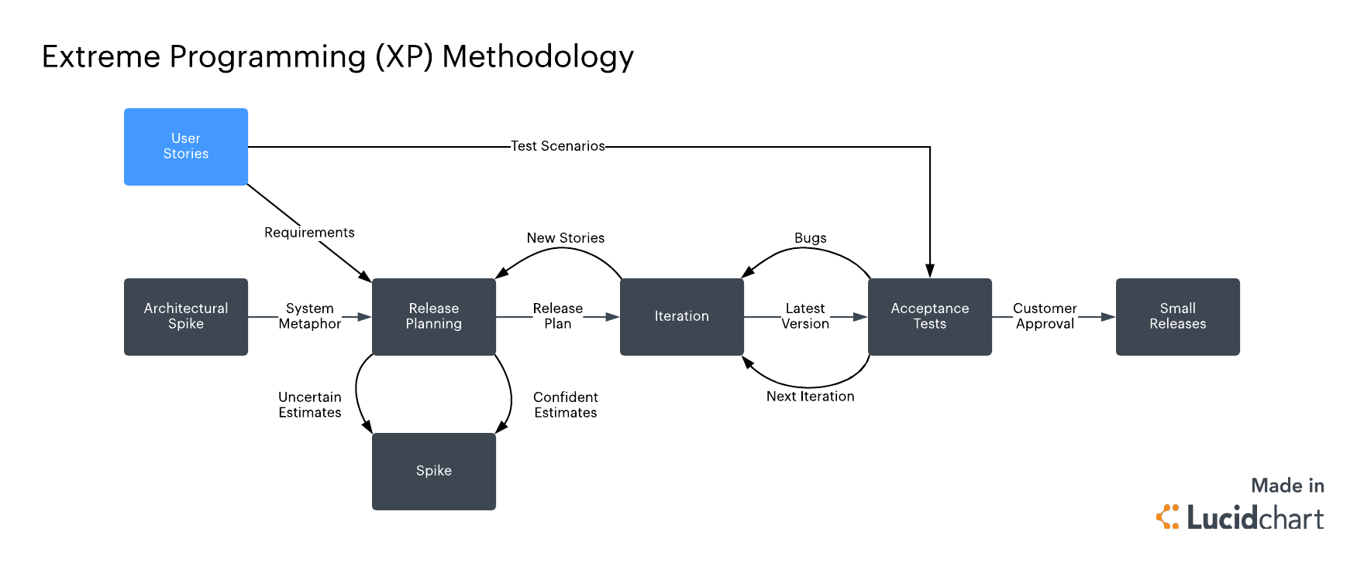
Research Methodology

Slide 15
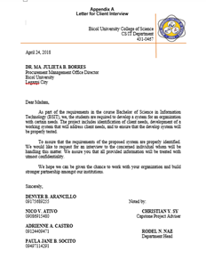
Letter for Client Interview

Slide 16
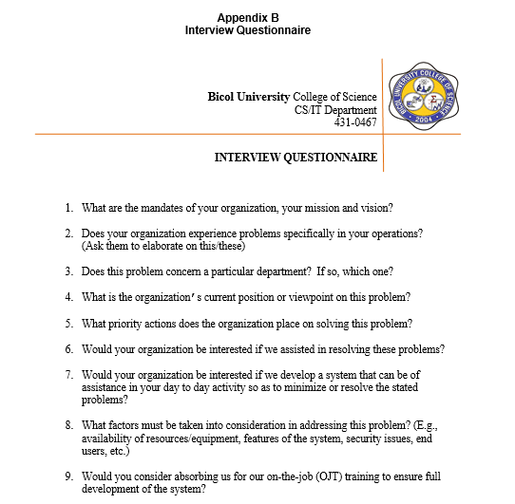
Interview Questionnaire

Slide 17
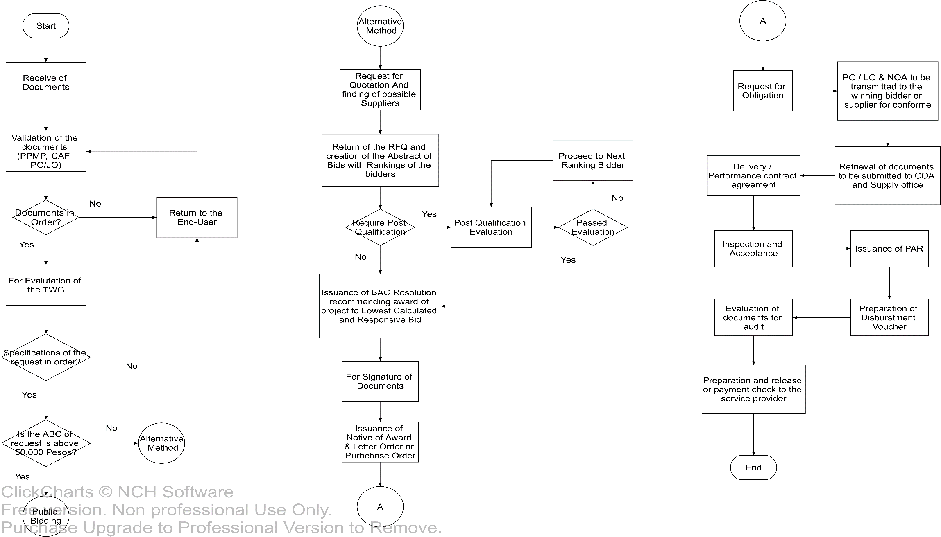
Flowchart

Slide 18
User Stories
ROLE | STORIES
PrMO Director | As a user I want to keep track the request sent from different colleges in order to organize the projects.
 | As a user I want to be reminded of the deadlines and tasks in order to meet deadlines the work efficiently
 | As a user I want to be able to follow up my request in order to communicate with the current standing of my project.
 | As a user I want the project to be recorded electronically rather than the manual logbook in order to help keep the records in an organize way and help lessen the manual writing.

Slide 19
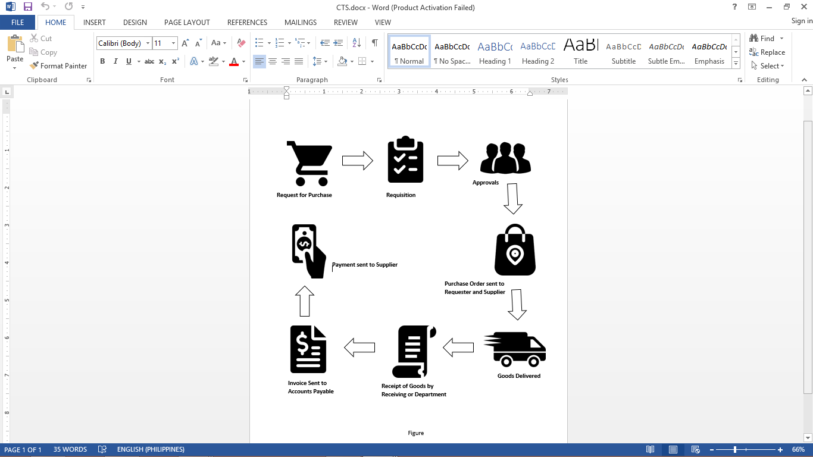
Current Technical Situation (CTS)

Slide 20
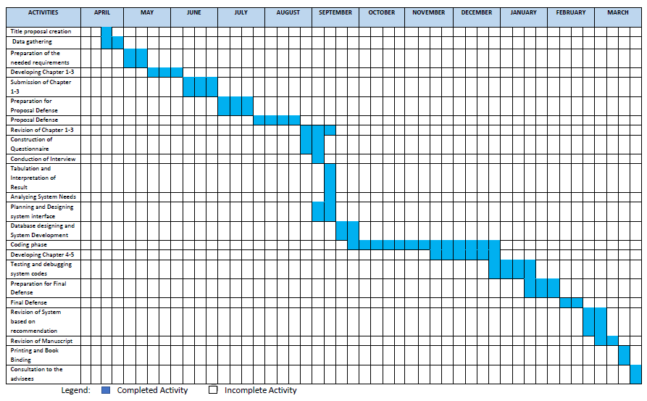
Gantt Chart

Slide 21
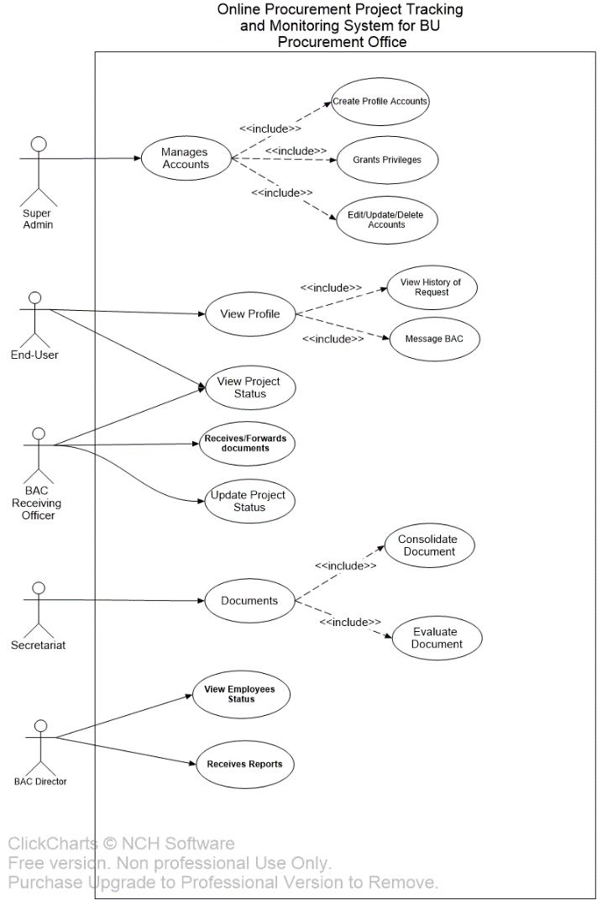
Use Case Diagram

Slide 22
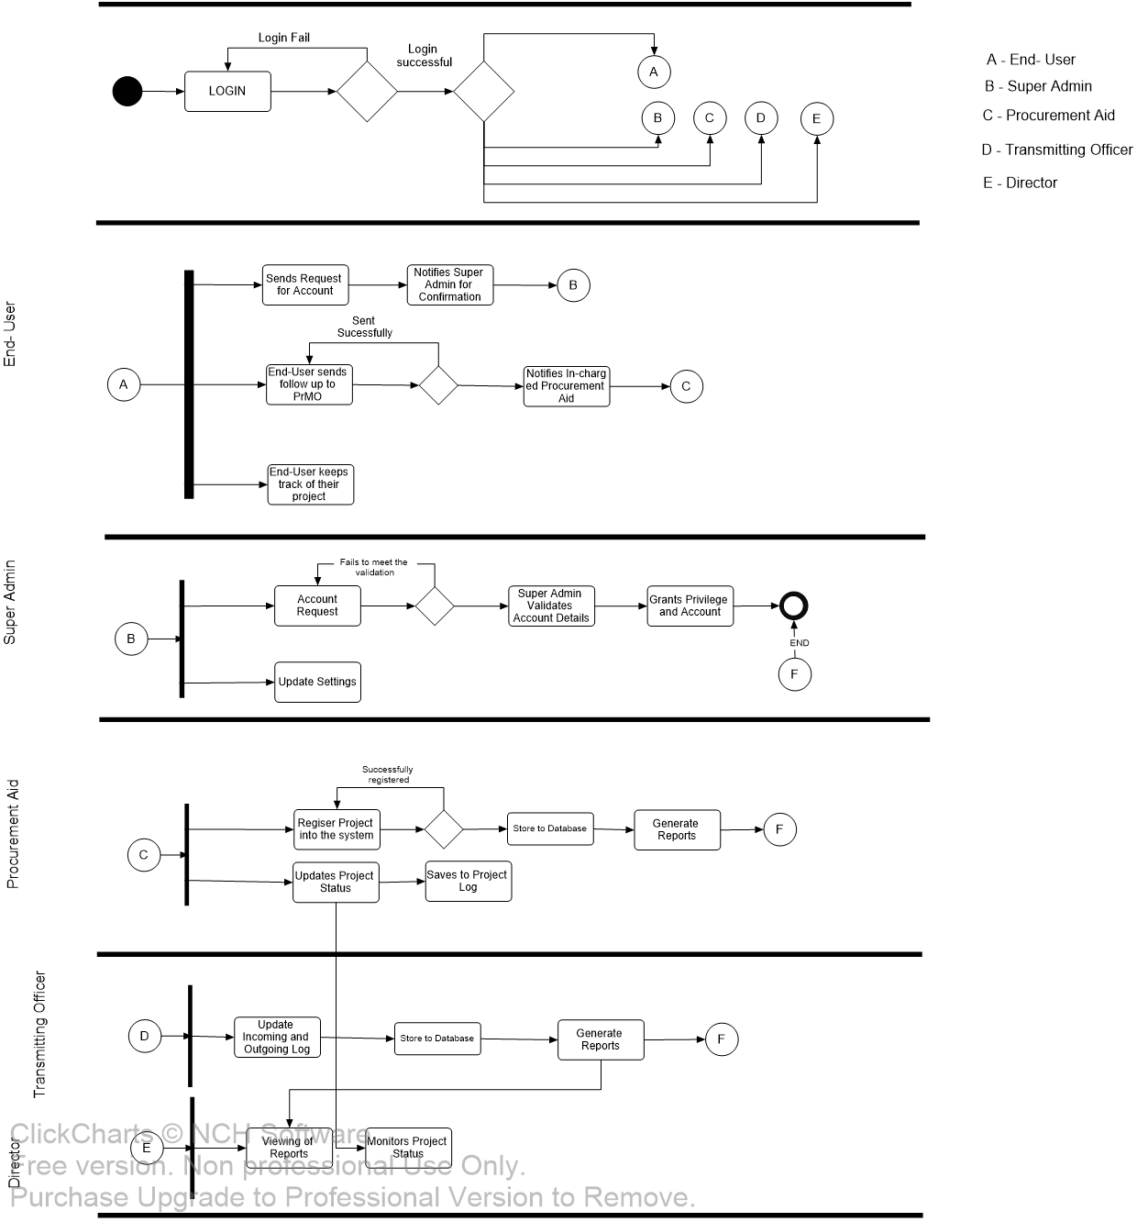
Activity Diagram

Slide 23
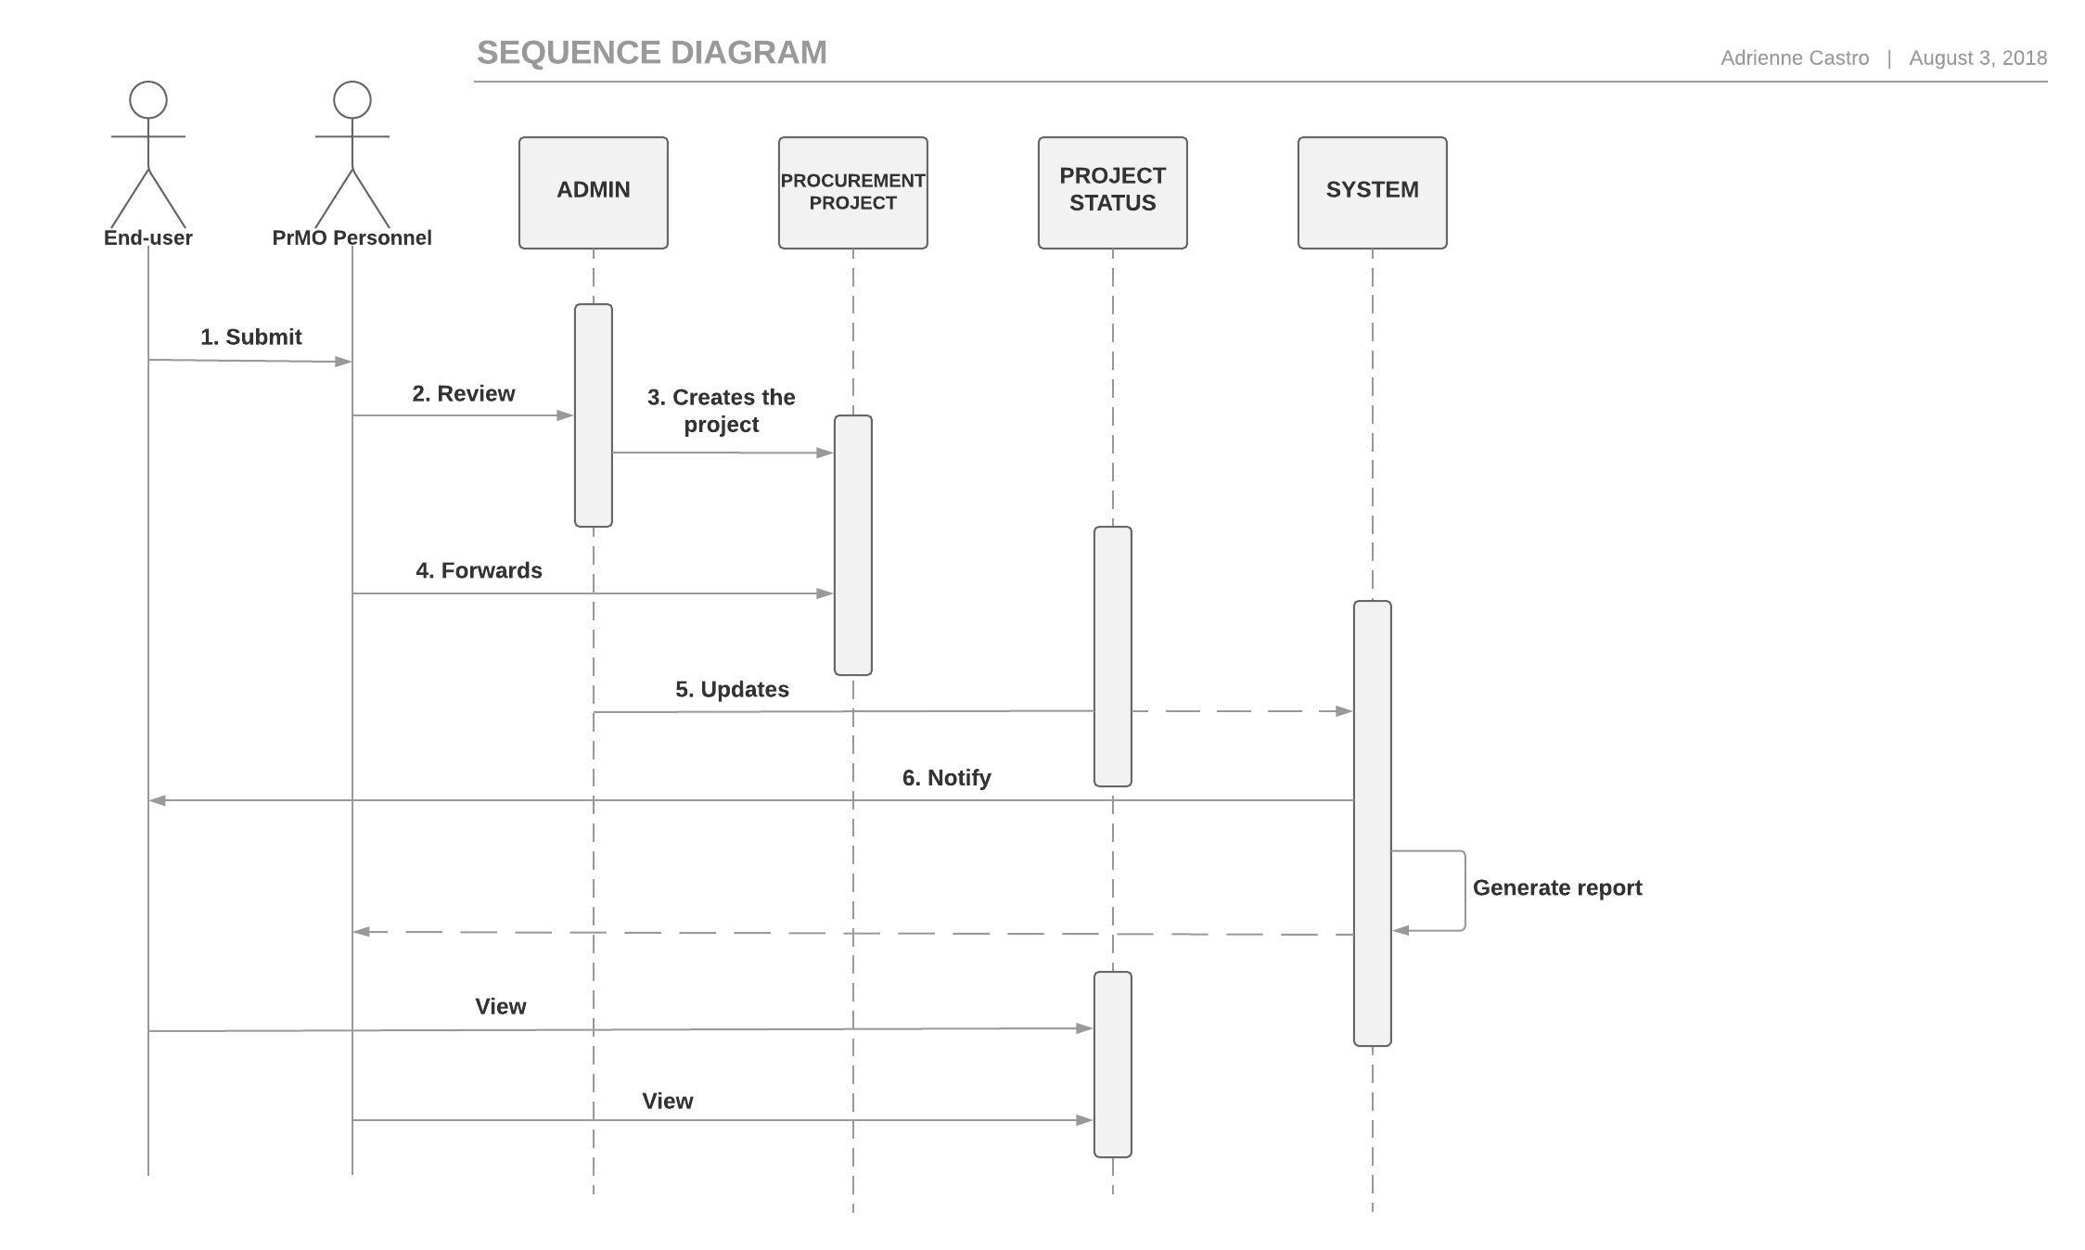
Sequence Diagram

Slide 24
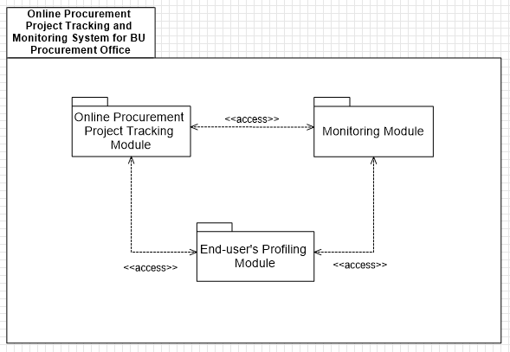
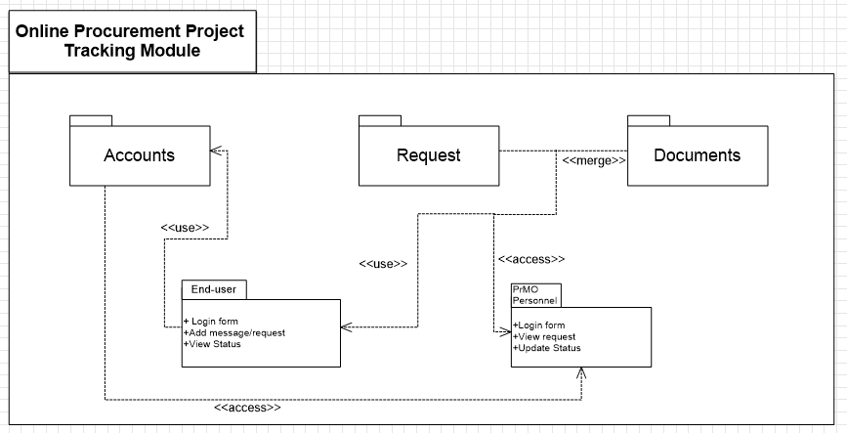
Package Diagram

Slide 25
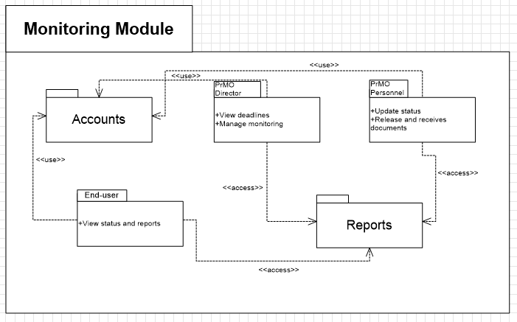
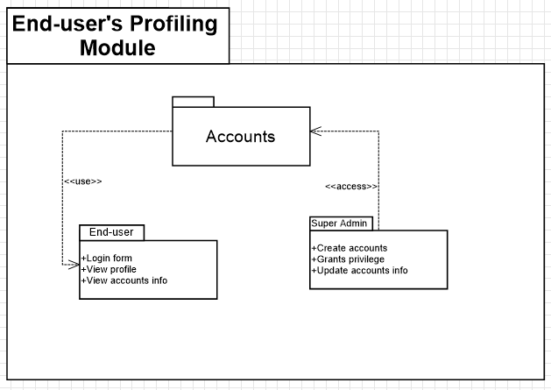
Package Diagram (cont.)

Slide 26
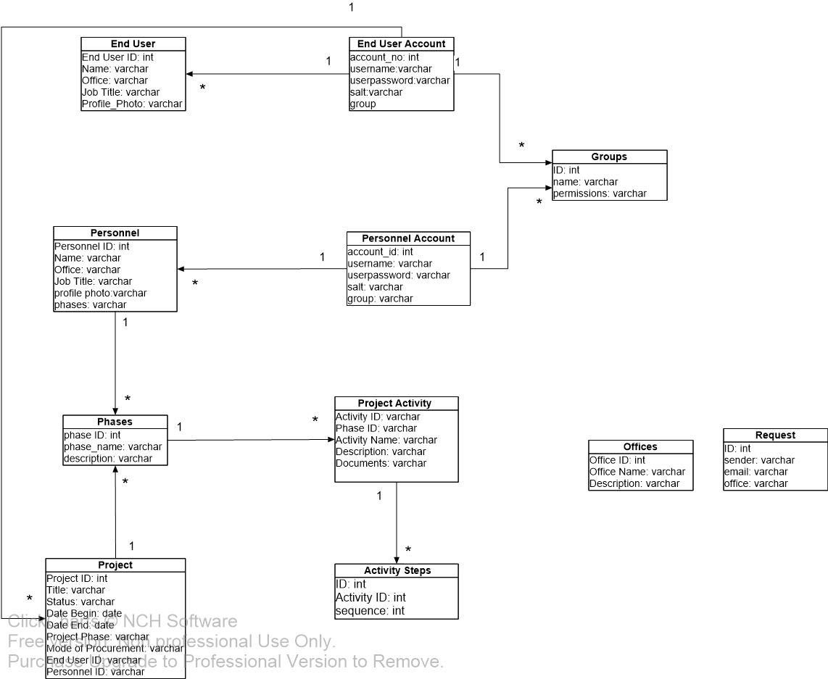
Class Diagram

Slide 27
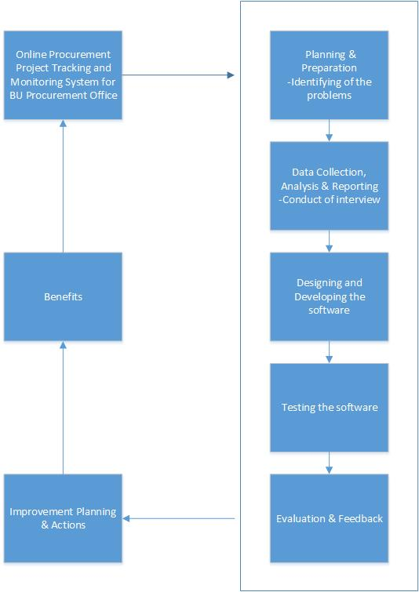
Conceptual Diagram

Slide 28
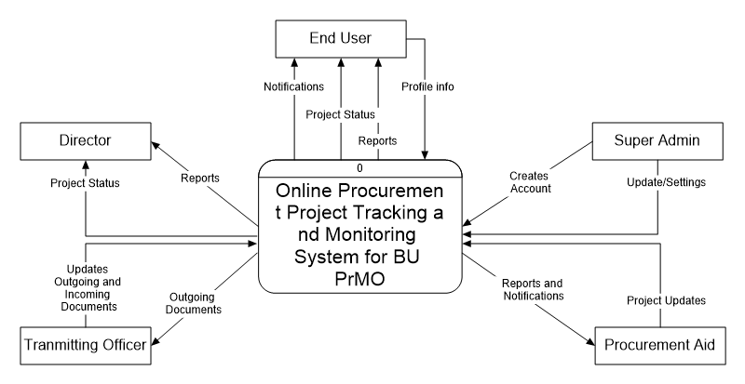
Context Diagram

Slide 29
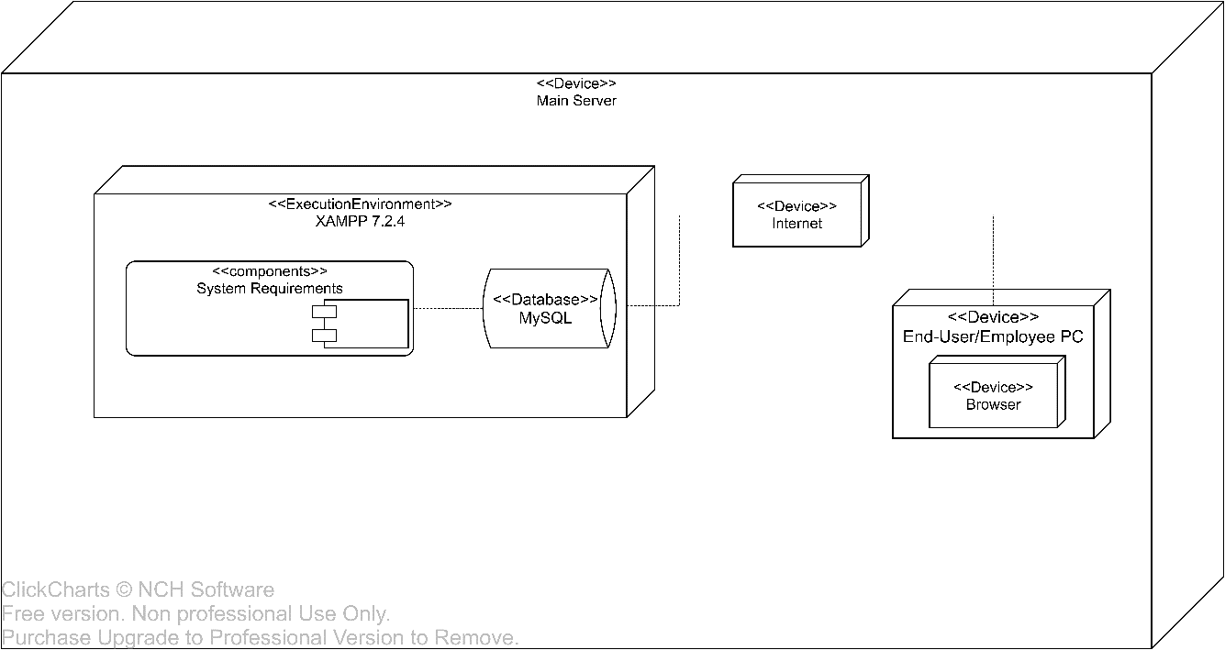
Deployment Diagram

Slide 30
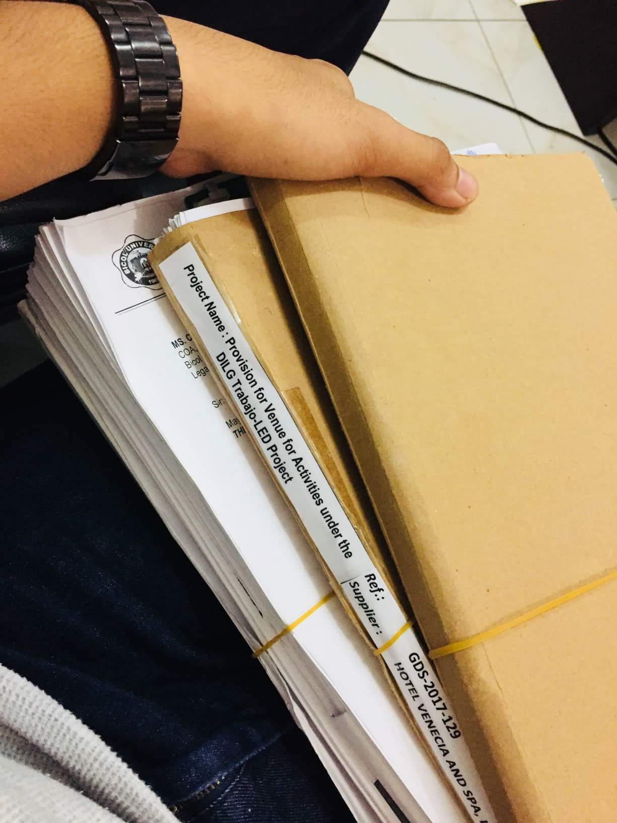
Sample Procurement Projects

Slide 31
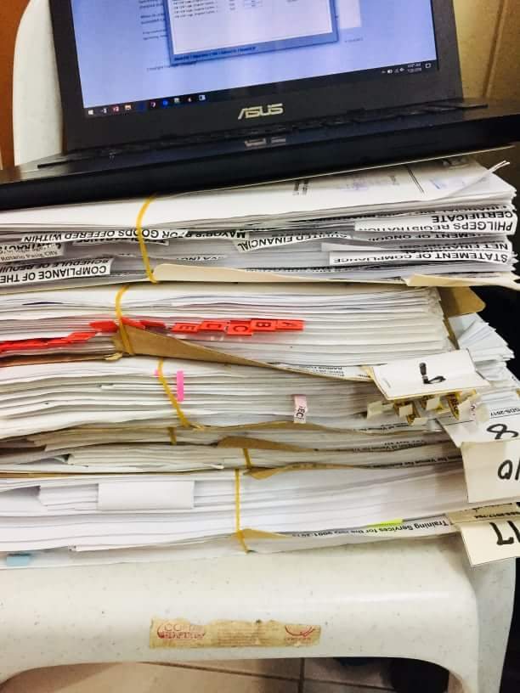
Sample Procurement Projects

Slide 32
THANK YOU! ☺

